Slide 1

Microsoft DataMarket:
Leveraging cloud to deliver public domain and commercial data to millions
Sudhir Hasbe
Sr. Product Manager
Windows Azure Platform
Microsoft Corp

Slide 2
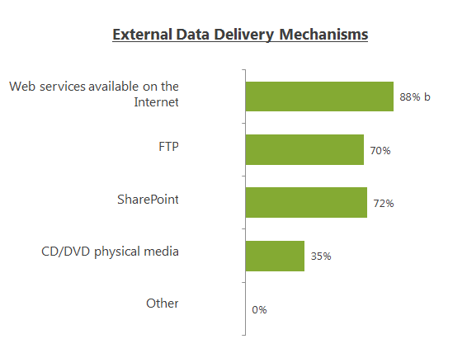
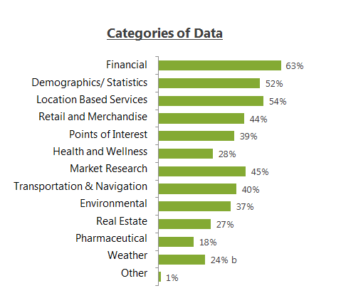
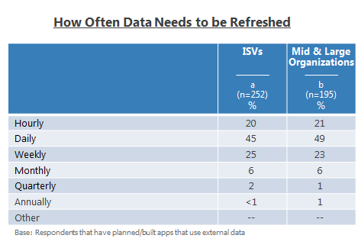
Enterprise Data usage
Source: Microsoft Research
Source: Microsoft Research

Slide 3



Challenge: Need to build new application
Relational
I need data!
Different Formats
Flat File
Hierarchical
FTP
Different Access
DVD
Database
Web Service
Credit card
Different Billing
Invoice
Free
Discovery
Semantics

Slide 4

Windows Azure DataMarket
Premium, Trusted, Secure
Information marketplace for ISVs and IWs that provides both trusted public domain and premium commercial data via integrated consumption experiences and easy data discovery, exploration, and purchasing.
  Discover, visualize, acquire, and consume structured and blob datasets
  to power any application – on any platform and any screen size.
  Data Visualization helps customers make better data purchase decisions
  Information Discovery
  Partner driven ecosystem and global reach to deliver data
  and functionality to developers and information workers.
  Subscribe to wide variety of datasets with in few clicks, Easy to consume secure APIs for content.
  Data
  Subscriptions
  Killer Experiences and Insights provided by MS or ISVs.
Integrations with Microsoft Excel, Microsoft PowerPivot, ISV applications
helps mash-up of data for the information worker.
  Killer
  Applications
  Built completely on the Windows Azure platform

Slide 5


Components
Premium, Trusted, Secure
IW Integration
APIs
Public Marketplace
Provisioning, Reporting and Billing Engine
DataMarket Connector
Data Hosted in Windows Azure
Data Hosted by SQL Azure
Data Hosted in Private DC

Slide 6
Demo
Marketplace, Excel, Facebook, Bing

Slide 7


Demo
Bruno Aziza
WW Strategy Lead
Microsoft BI
Jamie MacLennan
Chief Technology Officer
Predixion Software
www.microsoft.com\bi
www.bizintelligence.tv
www.predictionsoftware.com

Slide 8

Thank You!
www.predixionsoftware.com
jamiemaclennan.blogspot.com
Simon Arkell
CEO
sarkell@predixionsoftware.com
(949) 233 6396
Jamie MacLennan
CTO
jamiemac@predixionsoftware.com
(425) 246 8741

Slide 9





Benefits
Global reach
Unified billing & provisioning platform
Easy content onboarding
Data security / authorization model
Flexible pricing, auditing, logging
Consistent, flexible and
context optimized APIs
Single Contract – One Stop shop
Easy access to premium data
Unified billing and provisioning platform
Easy information discovery
Rich Apps to consume Data
Microsoft Office, Dynamics, Bing + 3rd party ISV Applications
Ability to mash up public and private data
Flexible pricing – pay as you go
Content Providers
ISVs and Devs
Information Workers
One Stop Shop for all data
Notes:
Mapping to Top level messages
1. Reduce operational costs while enabling scale & security: Integration services enable business efficiency though automation. Automation reduces manual labor and hence reduces cost.
2. Rapidly respond to the changing business environment: Good Integration strategy and solution provide your business to be agile and hence provides you the ability to respond to changing business environment. Dubai Bank was able to add service deliver channels for their banking services like web banking and mobile banking in very short period of time because of their investment in BizTalk server
3. Connect & empower people through familiar tools: In many organization value is hidden inside legacy LOB applications. With good integration services and architecture you can extract this value and put it in hands of your people. For example deliver better BI tools or productivity solutions on top of your exiting investments.

Slide 10
DataMarket Business Model
DataMarket is public marketplace to discover, purchase and use trusted premium
and public domain data
1
Content providers have complete control over data, terms of use, and price
of published datasets
2
Public domain data is free for all customers
3
Customers can purchase premium datasets by # of transactions or monthly subscriptions
4
Customers have access to Trial Usage and data visualizations to help make better data purchase decisions
5
Microsoft and Content providers will share revenue for all data sales
6
Notes:
Volume licensing and EAs
New revenue from high value services beyond brokerage: report galleries, data cleansing as a service, and killer apps
Higher margins by including vertical/user needs; bundles.
Attach to services (BI, RS in the cloud; Trending, Mining, etc)

Slide 11
Learn More…
Visit http://datamarket.azure.com to learn more
Download Excel add-in(https://datamarket.azure.com/about)
Contact us at datamarketbd@microsoft.com to sell/share your dataset
Visit our booth to learn more about Windows Azure DataMarket
Additional Sessions at Strata Conference
Wed 3rd Feb 10:40am
Open Data: Designing Data-centric Web APIs Pablo Castro (Microsoft)
Wed 3rd Feb 4:10pm
Data Marketplaces Julie Steele (O'Reilly Media, Inc.), Ian White (Urban Mapping, Inc), Peter Marney (Thomson Reuters), Moe Khosravy (Microsoft), Dennis Yang (Infochimps)

Slide 12

© 2011 Microsoft Corporation. All rights reserved. Microsoft, Windows, Windows Vista and other product names are or may be registered trademarks and/or trademarks in the U.S. and/or other countries.
The information herein is for informational purposes only and represents the current view of Microsoft Corporation as of the date of this presentation. Because Microsoft must respond to changing market conditions, it should not be interpreted to be a commitment on the part of Microsoft, and Microsoft cannot guarantee the accuracy of any information provided after the date of this presentation.
MICROSOFT MAKES NO WARRANTIES, EXPRESS, IMPLIED OR STATUTORY, AS TO THE INFORMATION IN THIS PRESENTATION.

Slide 13

Challenge: Need to build new application
Different Formats
Scenario
Dinner and a movie mobile
app using your location…
Requirements
Theater listings, Theater reviews, Movie database and reviews, restaurant hours, reviews, menus, crime and safety, etc…
Challenges
Finding data, different formats, different security models, different licensing, different billing relationship, not easy to mash up and consume
Flat file
Relational
Hierarchical
Different Access
FTP
DVD
Database
Web service
Different Billing
Credit card
Invoice
Free
Semantics
Discovery

Slide 14
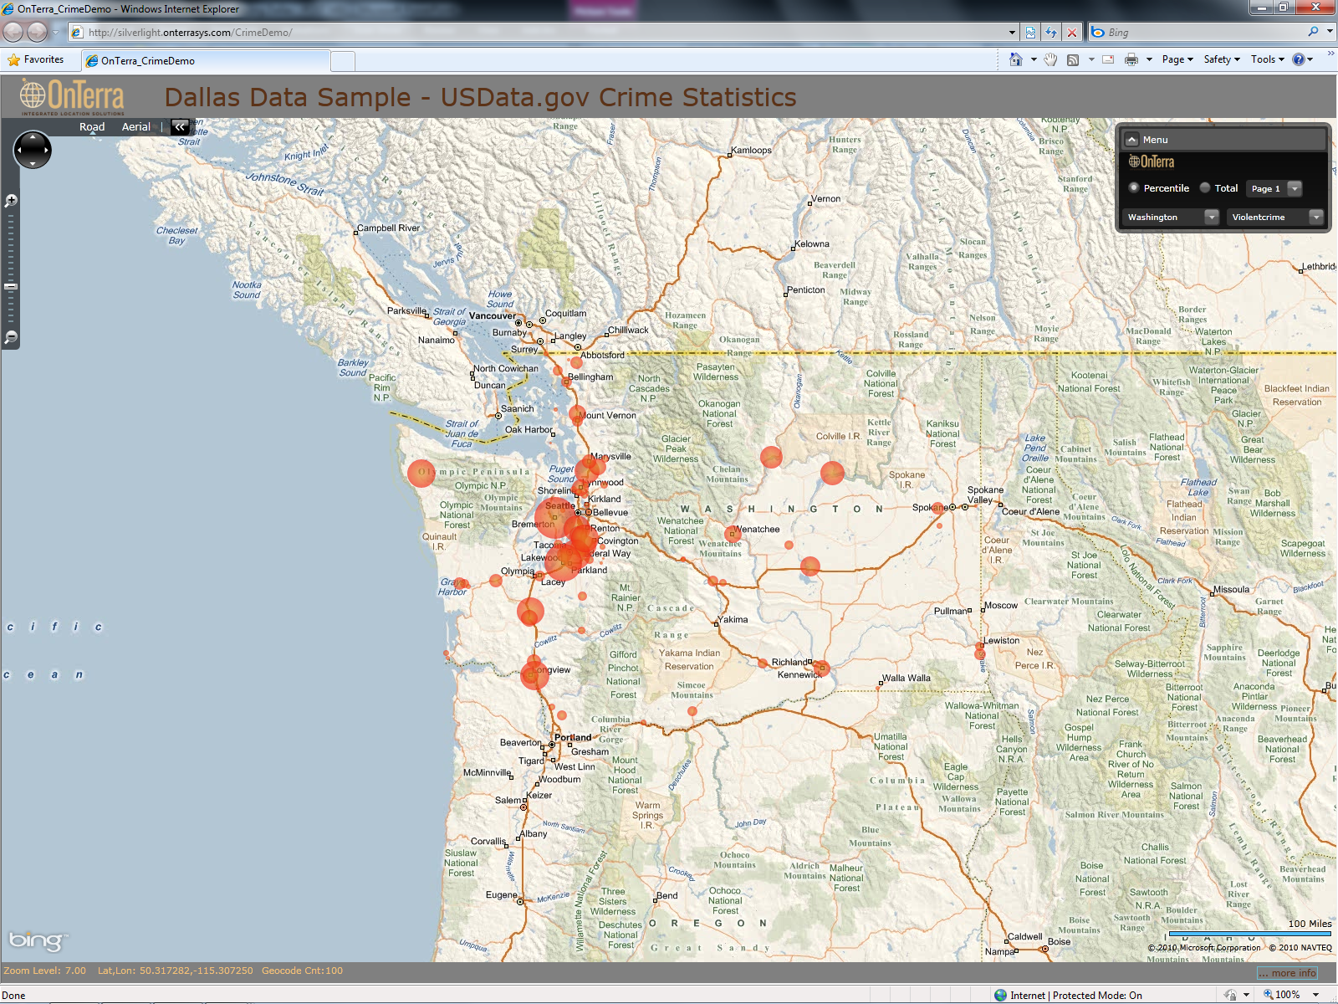
OnTerra: Mapping Crime Data
http://silverlight.onterrasys.com/CrimeDemo/

Slide 15
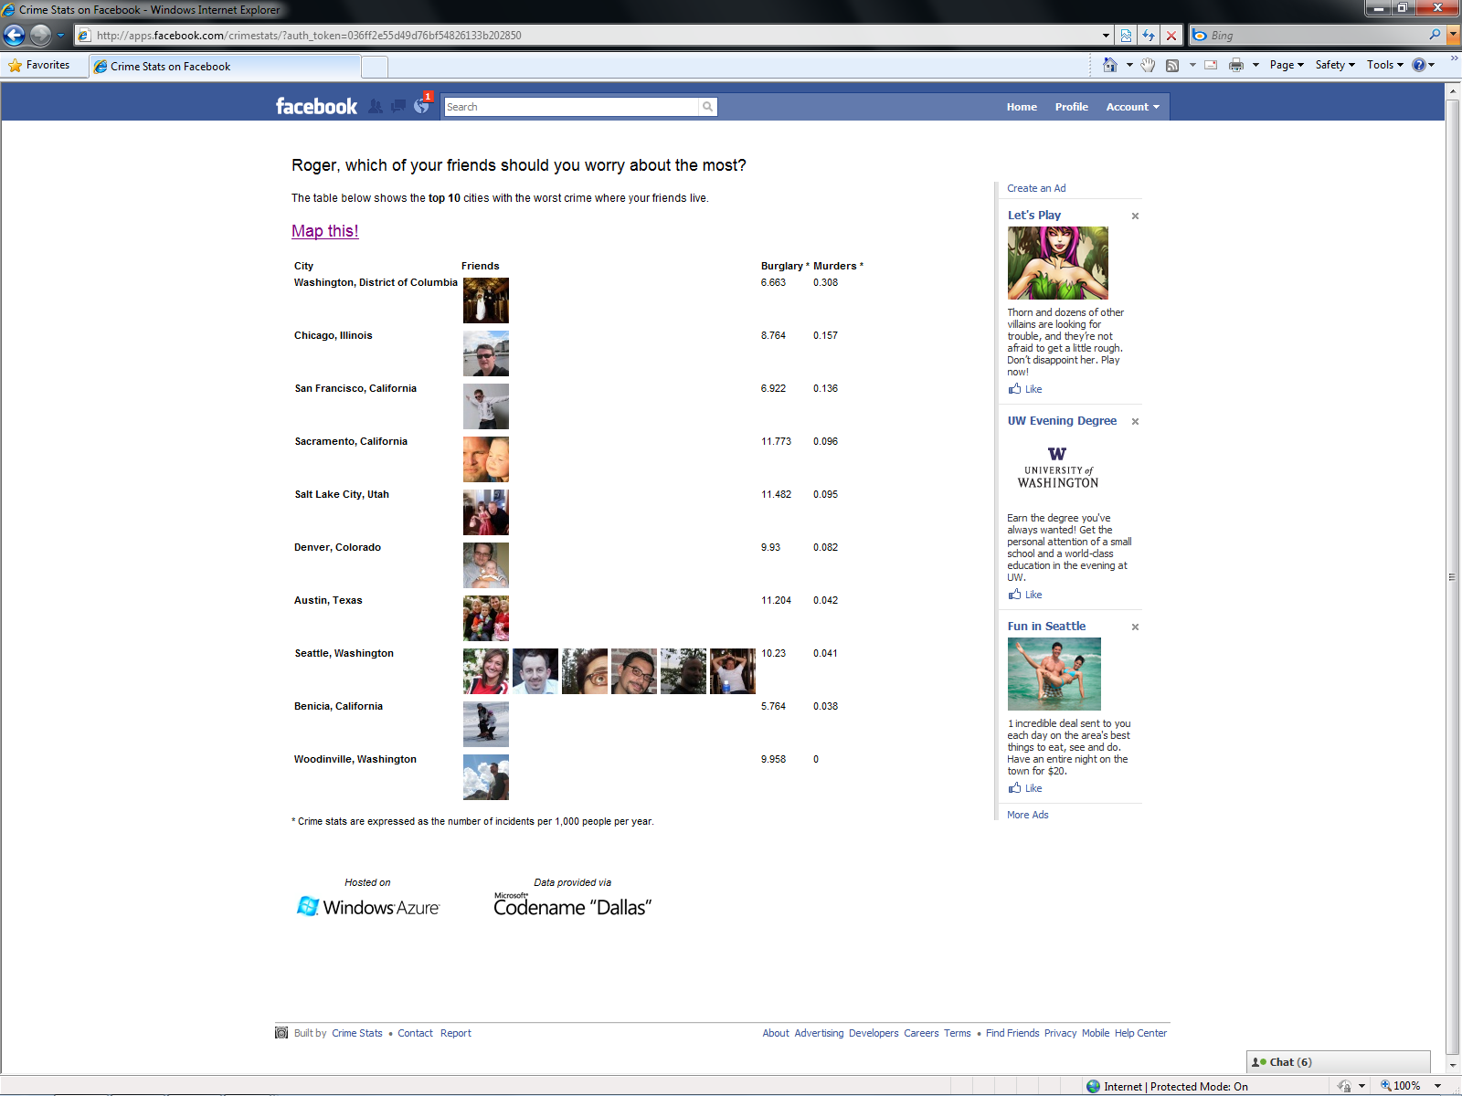
Facebook: Mash-up social network and crime data
http://apps.facebook.com/crimestats/Default.aspx

Slide 16
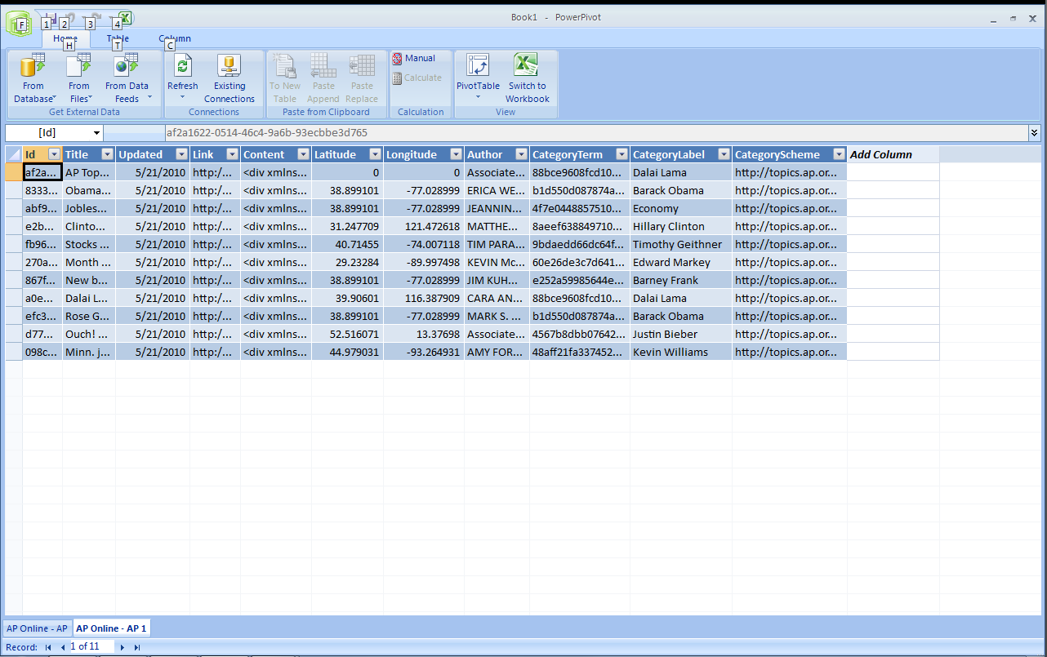
Office 2010 Integration
Download Excel add-in from http://go.microsoft.com/fwlink/?LinkID=204193

Slide 17
Scenarios by categories
Category | Content Providers | Scenarios
Demographic | UN, Alteryx, Data.Gov, Modul1, CDYNE, Melissa Data, StrikeIron, iLead Marketing | Mailing lists for Marketing campaigns Demand Planning based on consumer expenditure data Address verification Tax codes and Fraud detection
Environment/Weather | EEA, UN, Weather Central, WeatherBug | Demand Planning based on Weather Weather patterns, forecasts for shipping leadtimes Environment quality by region for travel planning
Financial | BarChart, Xignite, UN, CDYNE, CCH, Wolfram Alpha | Realtime Stock, mutual funds, futures in for for financial applications Currency conversions for foreign transactions Credit rating and Risk ratings for business transactions and supplier/customer ranking
GeoSpatial/Location Based Services | Zillow, ESRI, Alteryx, Boundary Solutions, DigitalGlobe, OnTerra | Mapping data for various mapping applications Home prices, demographic and maps for mapping applictions Mobile applications showcasing local information
Sports | Stats.com | Sports applications with historic sports statistics
Retail | Gregg London | DVD UPC information for online DVD sales or price comparison sites
Travel | UN, HungryGowhere, OnTerra, | Travel planning applications on web or phones

Slide 18
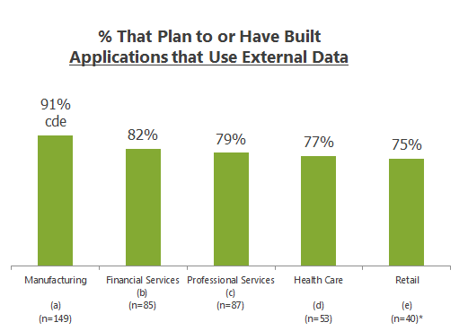
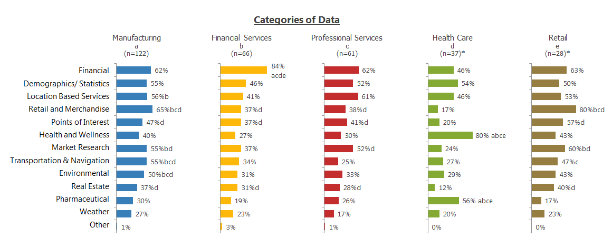
Enterprise Data usage by vertical
Includes Enterprise/Mid market and ISVS
Source: Microsoft Research

Slide 19
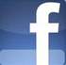


www.bizintelligence.tv
www.microsoft.com\bi
Notes:
Practice Fusion
Predixion Software
Innovative Cloud vendor for predictive analytics
Jamie, their CTO
27 patents in data mining
Popular author of 2 books on the subject
Bringing data from Azure marketplace into PowerPivot
Profiling data from
Building PowerPivot app
Performing predictive analytics in the cloud

Slide 20
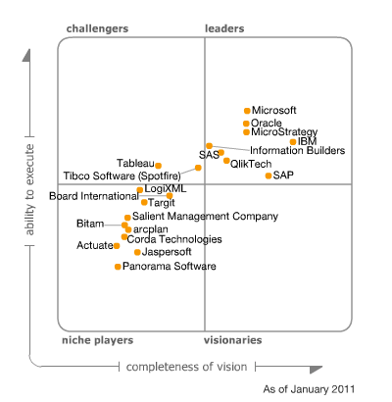
Microsoft a Leader in Gartner
BI Platform Magic Quadrant
Notes:
The vendor abstract is extremely positive including a number of highly favorable quotes:
“Microsoft customers cited TCO as the No. 1 reason for selecting Microsoft as a BI vendor, while cost was cited less frequently as a limitation to wider deployment for Microsoft than most other vendors in the survey”.
“Customers rating Microsoft above average across many key satisfaction metrics, including "sales and customer experience" (including product quality and support), "achievement of business benefits," as well as for "vendor success."
“Microsoft customers rate its BI platform infrastructure and development tools among the highest compared to other vendors, and a higher percentage of customers use them extensively.”
"Wide availability of skills is among the top reasons customers select Microsoft over competing vendors.”
“Customers in the Magic Quadrant survey report that their Microsoft average deployment sizes are now larger than any other vendor in the survey in terms of users”.
“Microsoft is the only BI platform vendor to tie its BI strategy tightly to its enterprise collaboration platform, SharePoint….Microsoft's BI customers have a very positive view of its collaboration-centric approach to BI.”

